Slide 1
Introduction to Time Series Analysis - I

Slide 2
Agenda
What is forecasting?
Why do we use forecasting?
Types of planning in forecasting,
Types of data,
Time Series,
Types of Time Series Analysis,
Difference between Uni-variate and Multivariate Analysis,
Applications of time series analysis

Slide 3
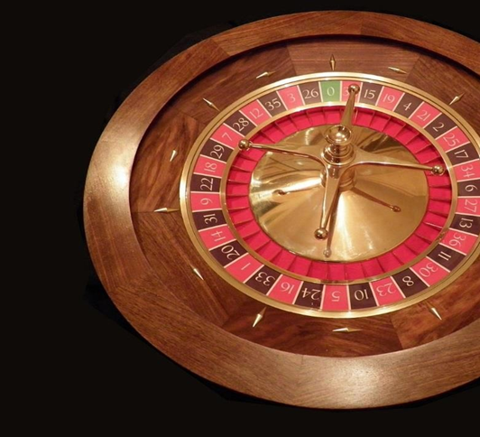

Topic name (Calibri 32, bold)
Consider two sequences of observations:
In a roulette game played in a casino, let 𝑦₁, 𝑦₂, … , 𝑦₁₀₀ be the outcomes of 100 rounds.
Let 𝑦₁, 𝑦₂, … , 𝑦₁₀₀ be the closing prices of a stock for 100 consecutive days.
Difference between the nature of outcomes of two experiments?

Slide 4
Topic name (Calibri 32, bold)
Classical Statistical Inference procedures => Independent observations are obtained under identical conditions (identically independently distributed)
Time series data => Chronological sequence of observations recorded at specific time intervals such as hours, months, or years etc. over a period of time
Time series data at adjacent points are dependent
Is dependence of observations a curse or advantage?

Slide 5
Data collected are of different types
Cross-sectional and Time series data
Cross-sectional data => Observations come from different individuals or groups at a single point in time. Samples are constructed by collecting the data across a range of observational units – people, objects, firms – simultaneously.
Examples:
Closing prices of a group of 20 different tech stocks on 30th June 2021.
Data on maximum temperature, humidity, wind speed of 13 coastal districts of Tamil Nadu on a particular day, say 31st July 2021.
Stock returns earned by shareholders of Tata Consultancy Services, Infosys, and Reliance Industries as for the year ended 31st December 2020. Cross-sectional sample can describe the performance of returns at a particular time point.
If the stock returns of different companies are increasing or decreasing over time?

Slide 6
Time-series data =>Set of observations collected at usually discrete and equally spaced time intervals.
Examples:
Daily closing price of TCS recorded over the last six months
Weekly sale figures of coffee at a coffee shop during January- December 2020
Quarterly data on GDP of India during 1980-2020
Monthly data on number of cancer patients visiting a hospital
during 2001-2020
Annual Cancer Mortality data of US during 1999 – 2019
Time series data focuses on the same variable over a period of time while cross sectional data focuses on several variables or several units at the same point of time.
Important to identify the correct type of data. Important to collect correct types of data.

Slide 7
Panel or Longitudinal data => Observations on different cross sections across time.
Examples:
Stock returns earned by shareholders of Tata Consultancy Services, Infosys, and Reliance Industries at the end of years 2001-2020.
Quarterly data on GDP of eight SAARC countries during 2011-2020.
Annual Cancer Mortality data of different Indian states during 2001 – 2020.
Daily observations on maximum temperature, humidity, wind speed of 13 coastal districts of Tamil Nadu during January- December 2020.

Slide 8
Time series analysis include
Methods for analyzing time series data to extract meaningful characteristics
Study the past behavior
Identify the pattern of observed time series
The established pattern can be used to forecast future values

Slide 9
Applications
Economic Forecasting
Financial Market Analysis
Marketing and Sales Forecasting
Census Analysis
Yield Projections
Weather forecasting
Stock market analysis
Insurance benefits prediction
Forecasting the number of sales or claims in Insurance sector
Network Data Analysis => network uses prediction
Signal processing => Distinguish between signal and noise

Slide 10
Components
of Time Series

Slide 11
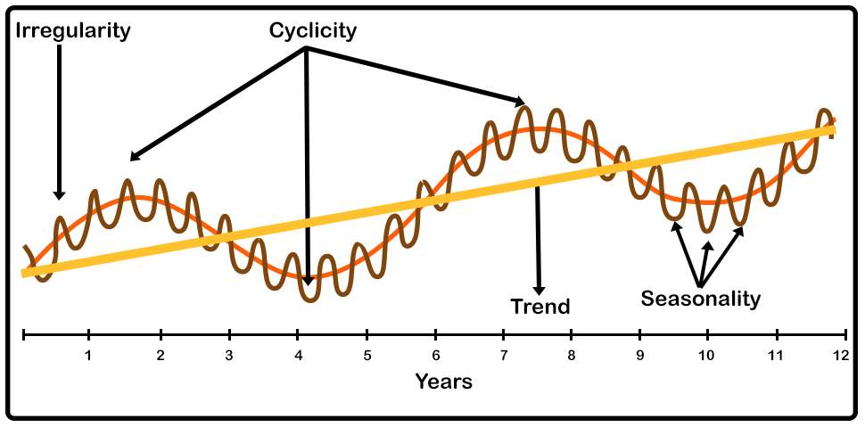
Components of Time Series
The Components of time series are Level, Trend, Seasonality, Cyclicity, Noise

Slide 12
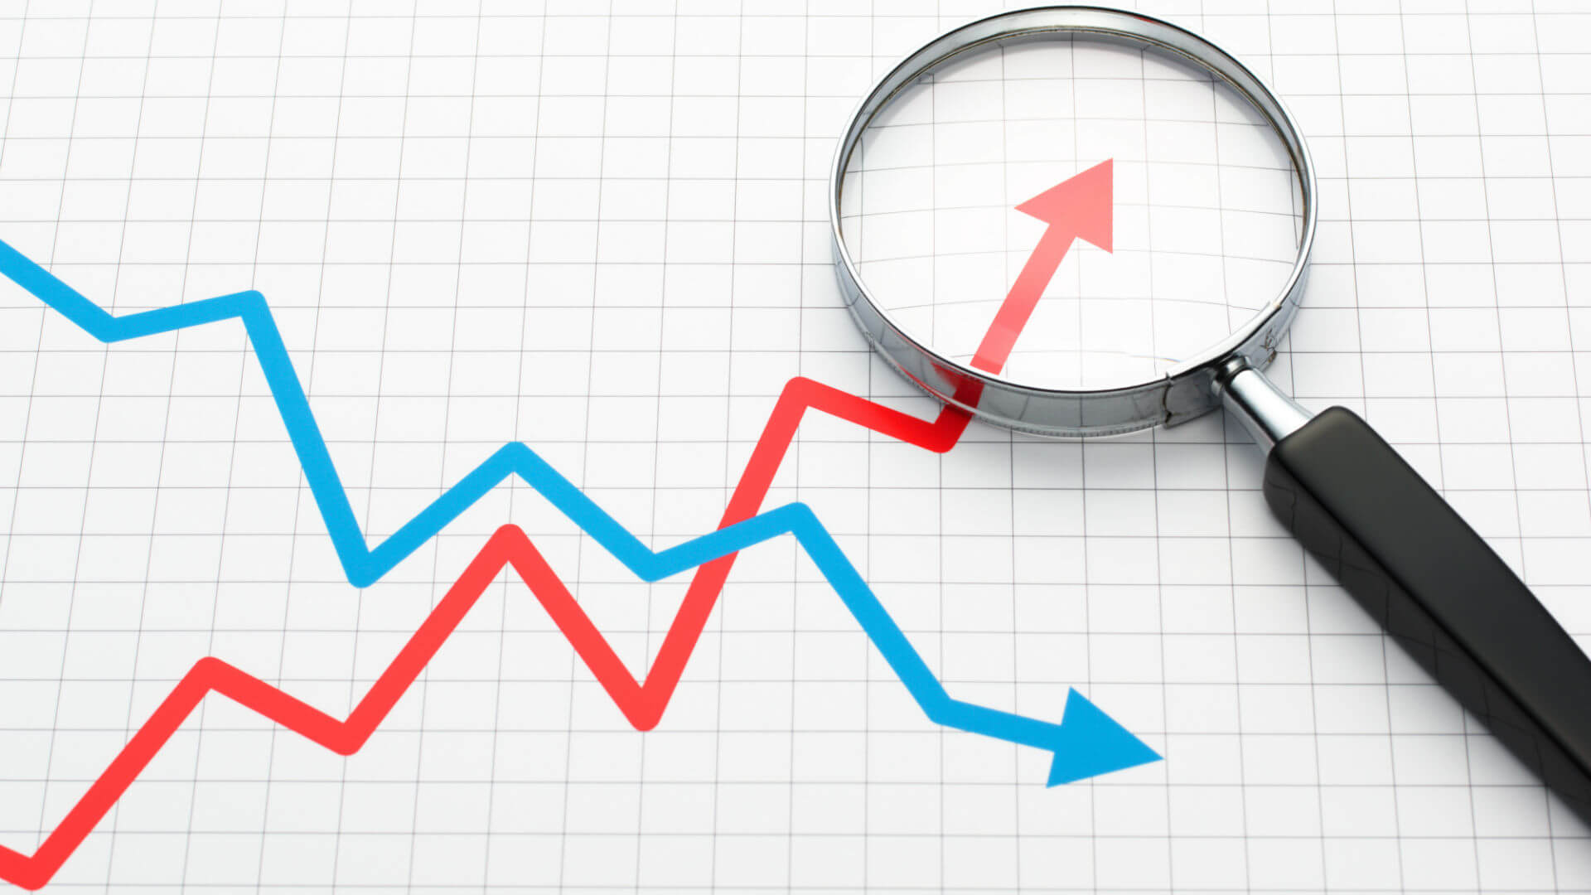
Time series Component: Level
Level is the baseline for the entire time series. It is the average of the time series and the baseline to which we add different other components.

Slide 13

Time series Component: Trend
The Trend is the indication of whether the time series has moved higher or lower over the time period.

Slide 14
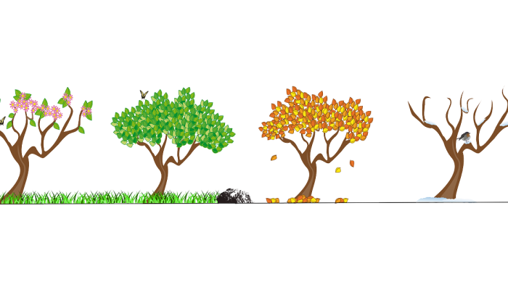
Time series Component: Seasonality
Seasonality is the pattern in time series which repeats after a fixed interval of time.

Slide 15
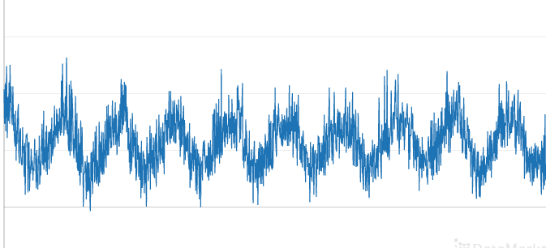
Time series Component: Cyclicity
Cyclicity is the pattern in the time series which repeats itself after some interval of time but the interval of time is not fixed in the case of cyclicity unlike the seasonality.

Slide 16
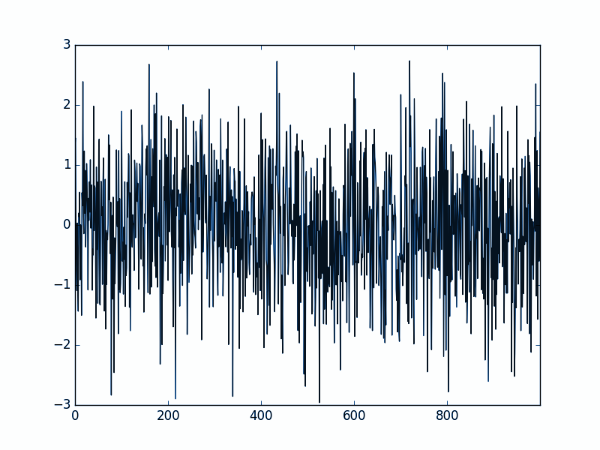
Time series Component: Noise
Noise is the random variation in the time series. We can not use noise to forecast the future.
Noise is just random fluctuations in our data and does not have any Pattern

Slide 17
End

